Slide 1
HOOPS Training Notes
Jerome Geronimo & Rustom Garcia
May 27,2019

Slide 2
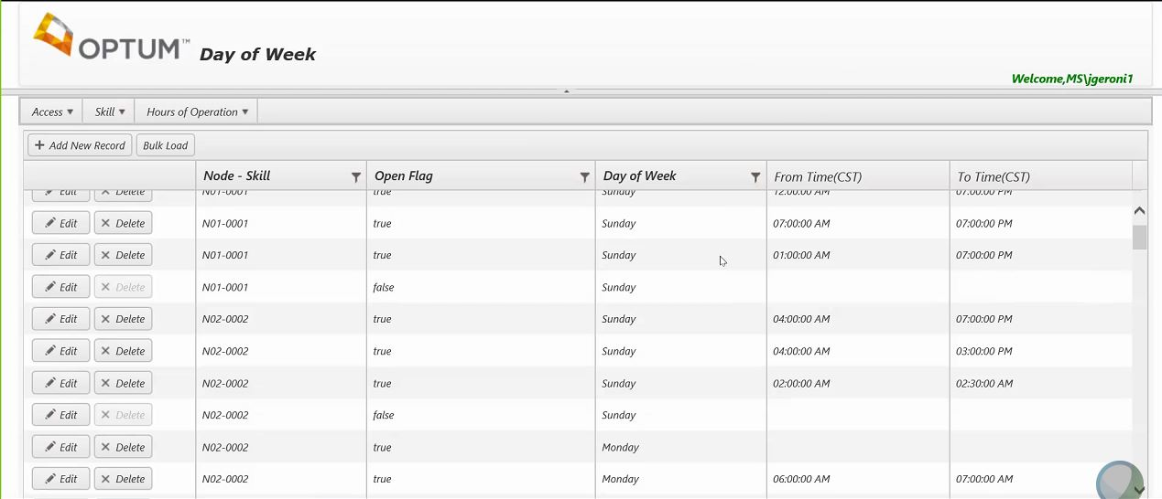
HOOPS: Stage Server
Link for Stage: http://webes0903:9090/HOOPS/HOOPSDOW/Index
Link for Prod: https://svcvccworkintake.uhc.com/HOOPS

Slide 3
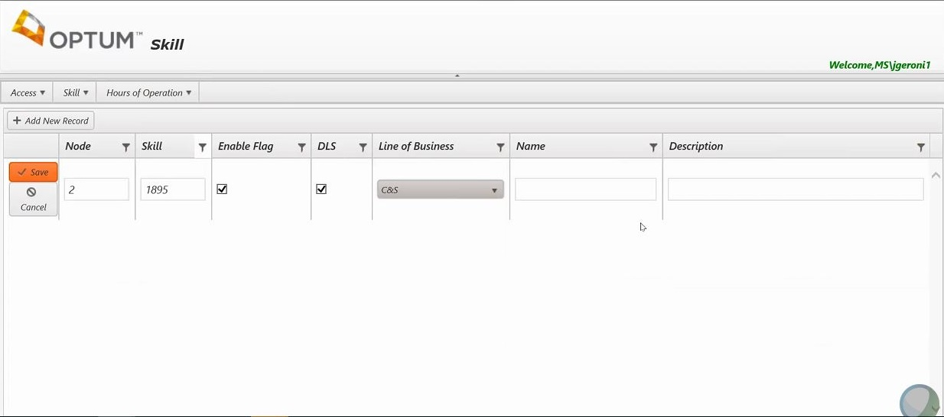
HOOPS: Adding the skill
Enable Flag means the skill is open or closed (True/False)
DLS means Daylight Savings

Slide 4
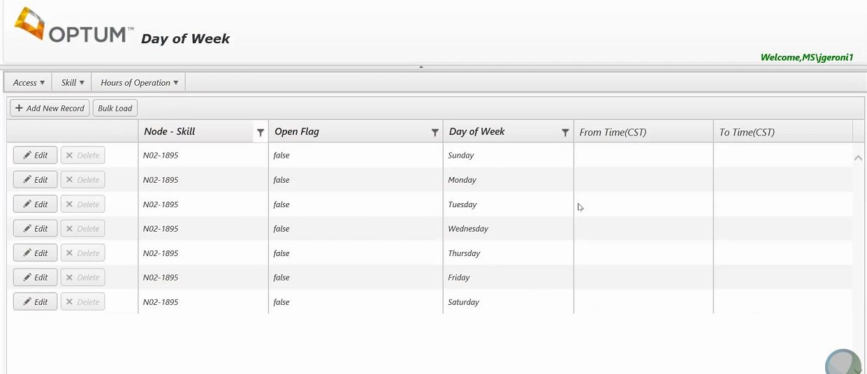
HOOPS: Hours of Operations Day of Week
Use filter to find the skill you will configure.
Here you can edit the time for each day of the week.

Slide 5
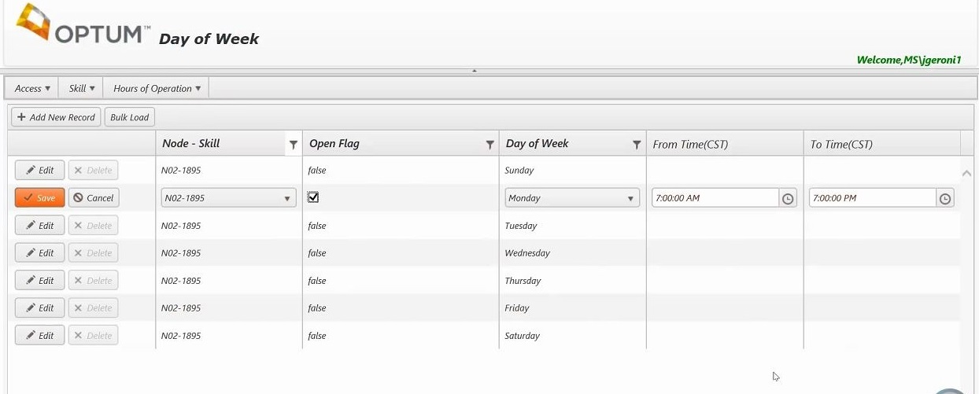
HOOPS: Hours of Operations Day of Week
Open flag means the day is open and lets you edit time for that day
Time is set by default to 7:00AM to 7:00PM

Slide 6
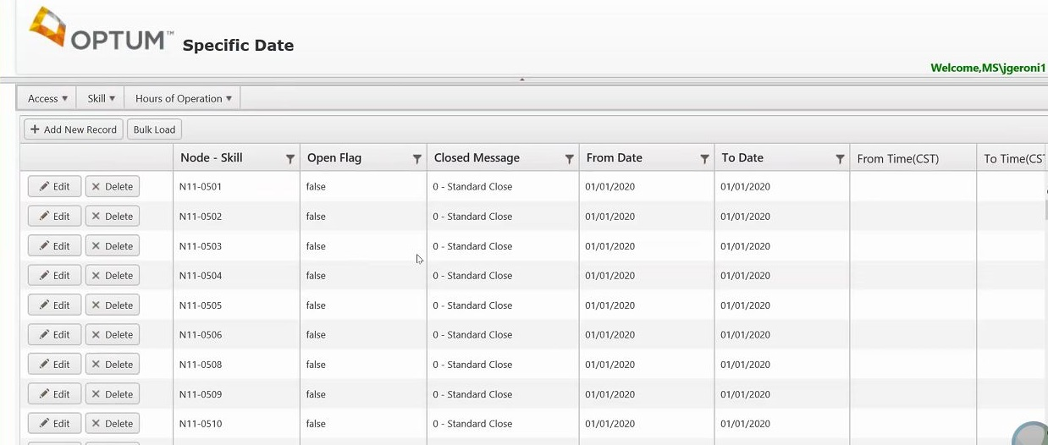
HOOPS: Specific Date
Configurations here overrides the configurations made in “Day of Week”

Slide 7
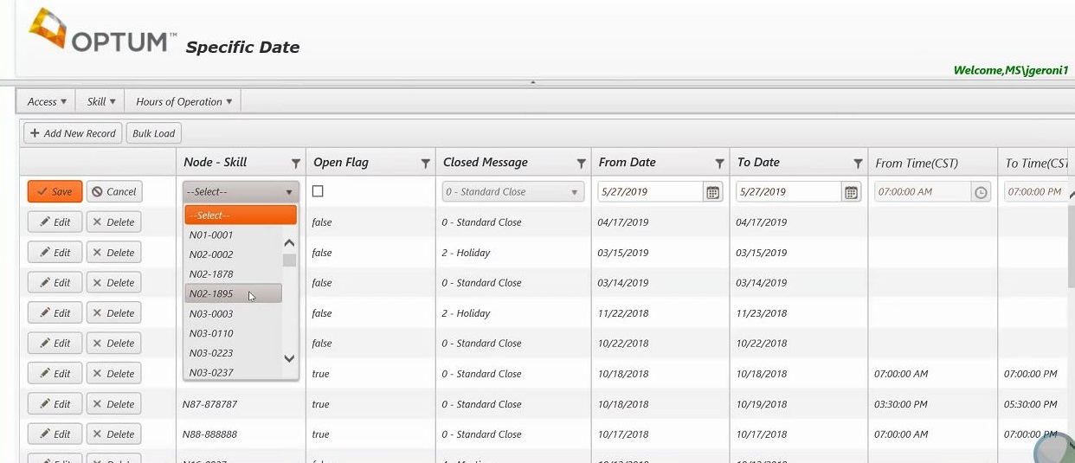
HOOPS: Specific Date
Variables sent to ICM: 0-closed; 1-open; 2-holiday; 3-emergency; 4-meeting

Slide 8
HOOPS: Line of Business
Note: The skill has to have a business unit set up for custom messages. Not all LOB use it
Go to access tab, Line of business option.

Slide 9
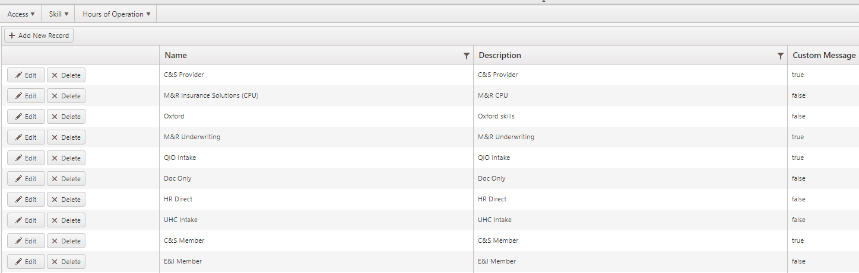
HOOPS: Line of Business
Warning: If you try to bulk upload Specific Dates (for holiday for example), and you set the custom message to 2-Holiday, but the LOB is not one set up, your bulk upload will fail.

Slide 10
ICM Hoops Configuration

Slide 11
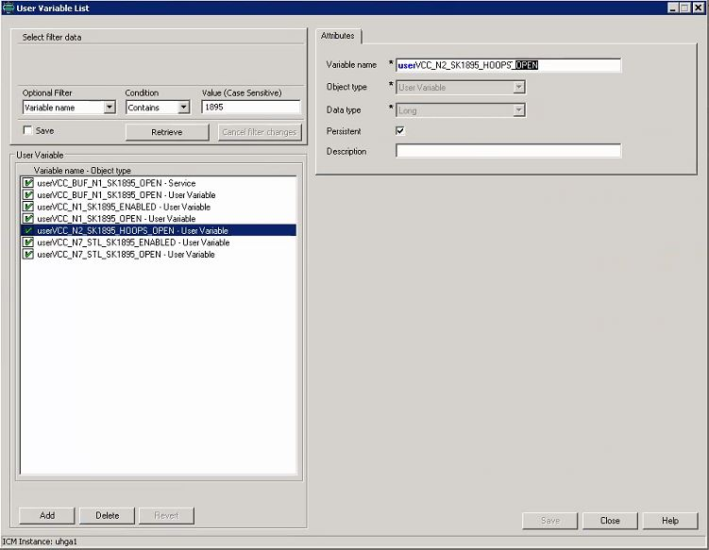
ICM Part: User Variable List
Add the skill user variable here before it is configured in the admin script.

Slide 12
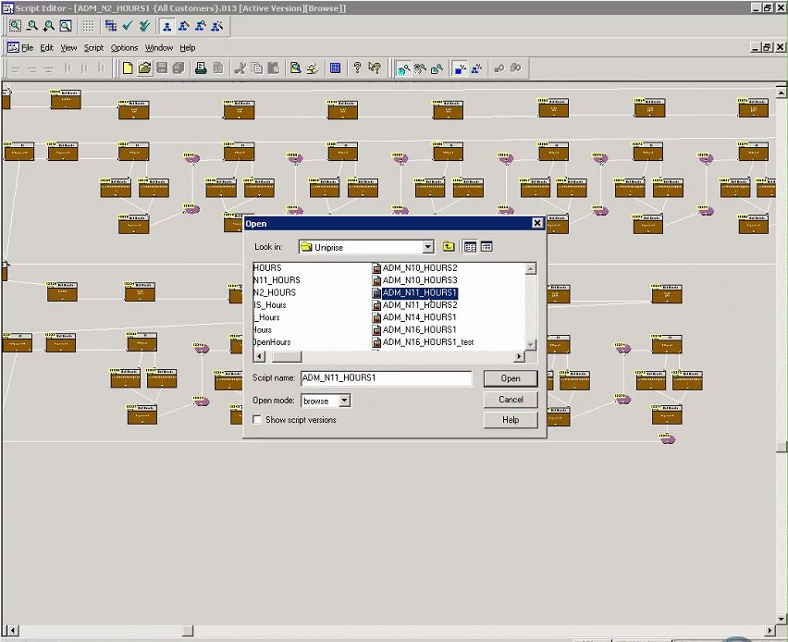
ICM Part: HOOPS Admin Script
It is where the Lightspeed Gateway receives the variable from HOOPS server and assigns it to the specific skills.

Slide 13
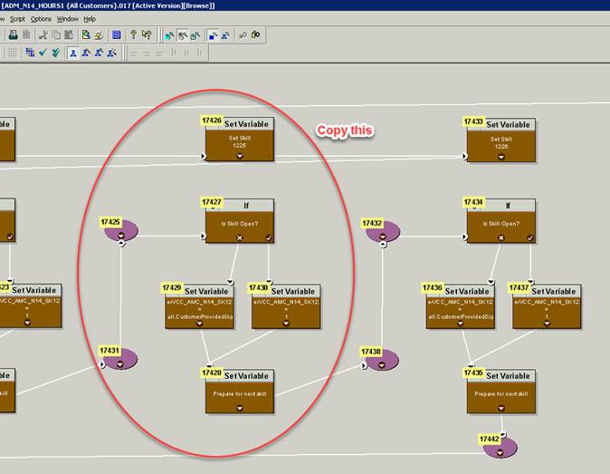
ICM Part: HOOPS Admin Script
For new skill setup:
Note: it’s easier if you copy the chunk of one skill setup before the last one. Less reconnections and changes will be made

Slide 14
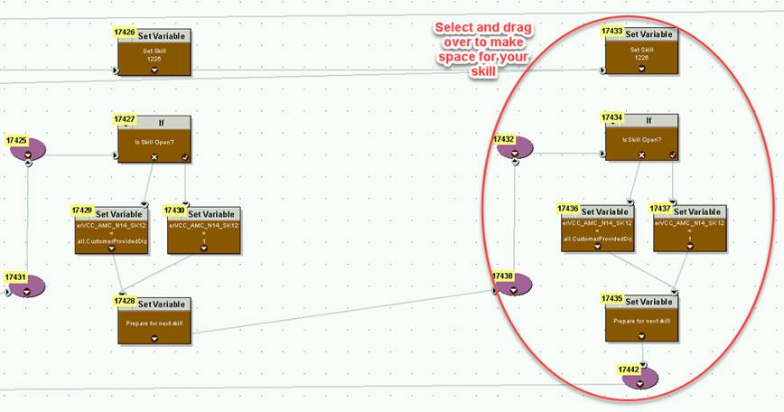
ICM Part: HOOPS Admin Script

Slide 15
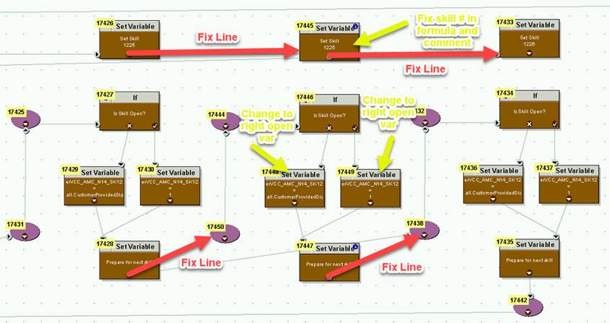
ICM Part: HOOPS Admin Script
Paste the copied set of nodes in the space created.
Note: Don’t exceed 40 skill checks per row.

Slide 16
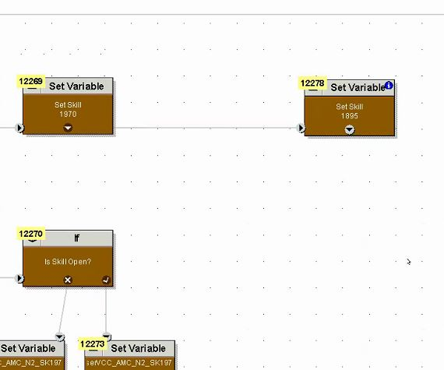

ICM Part: Admin Script
Double click the set variable node (Set skill) then edit the set variable value with the skill to add
Make sure to edit the comment tab as well.

Slide 17
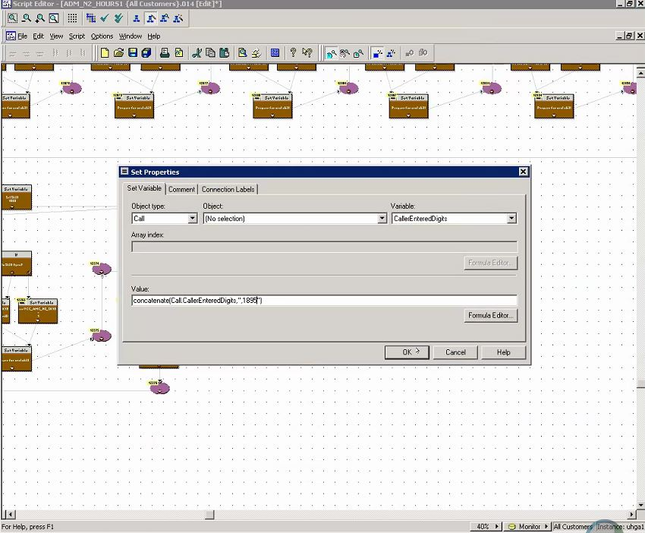
ICM Part: Admin Script
Double click the set variable node (Set skill) then edit the set variable value with the skill to add
Make sure to edit the comment tab as well.

Slide 18
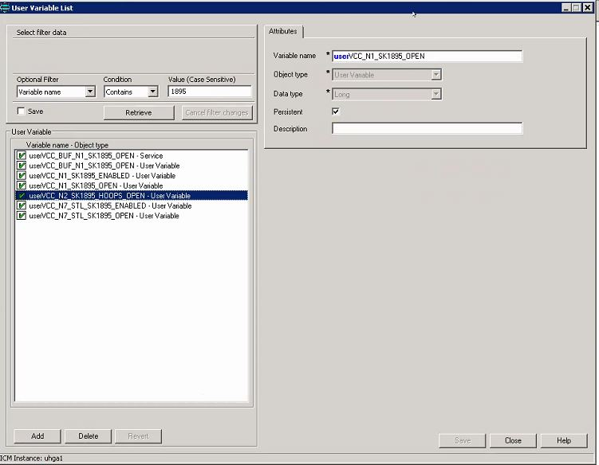
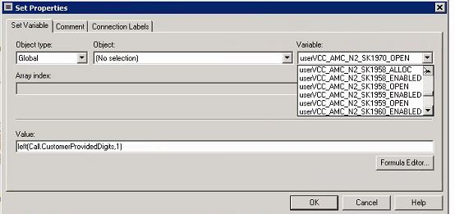
ICM Part: First Set Variable Value = left(Call.CustomerProvidedDigits,1)
Edit the variable node on the left by changing the Variable to the newly-added variable.

Slide 19
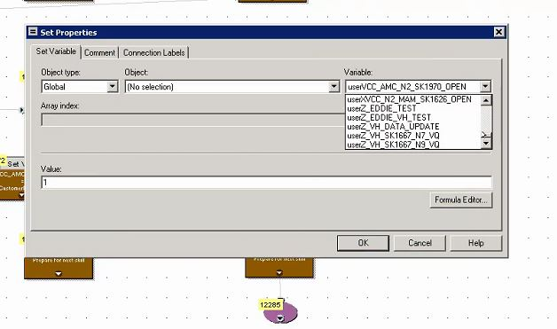
ICM Part: Second Set Variable Value = 1
Change also the second set variable node for the open path with value set to 1.

Slide 20
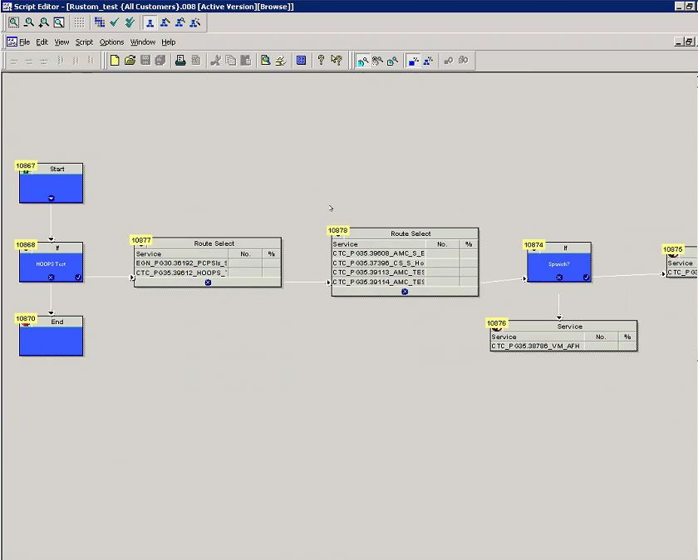
ICM Part: Routing Script
Sample routing script in ICM 2.

Slide 21
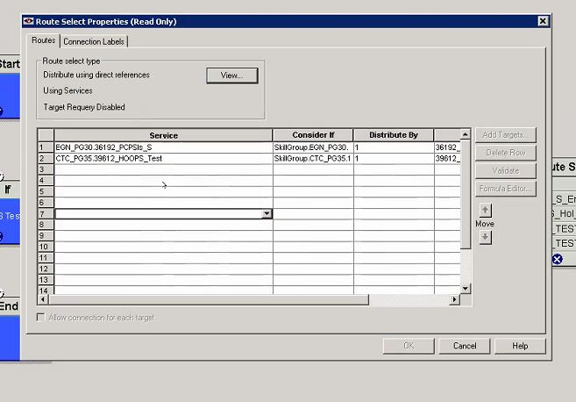
ICM Part: Routing Script
2 Services on the first route select node: one for Spanish routing and one for English routing

Slide 22
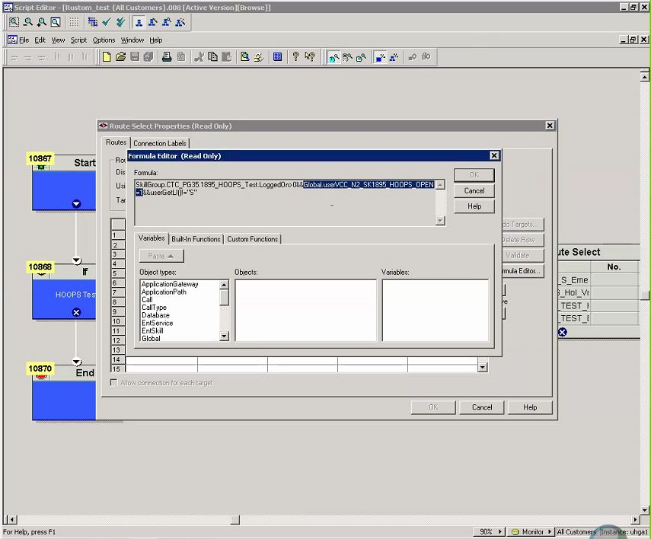
ICM Part: Routing Script
Consider If includes OPEN=1 Flag (and Language Indicator in this example) check.

Slide 23
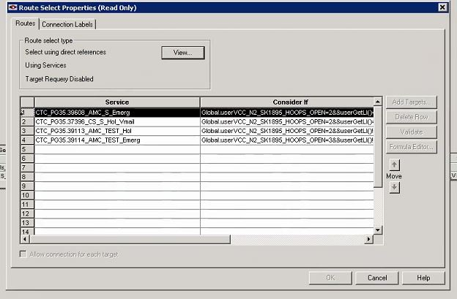
ICM Part: Routing Script
If OPEN=1 is not satisfied, it will route to the next Route Select where it checks for OPEN=2 and OPEN=3.

Slide 24
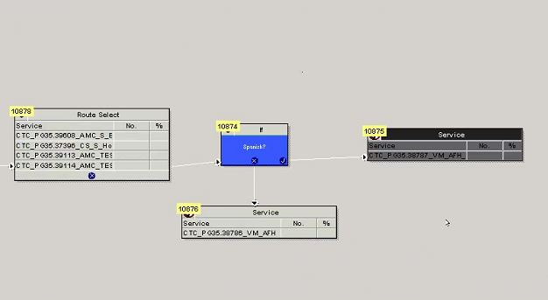
ICM Part: Routing Script
If OPEN =1,2 and 3 are not satisfied, it will route to the after hours treatment services where it could play a closed announcement or Voicemail.

Slide 25
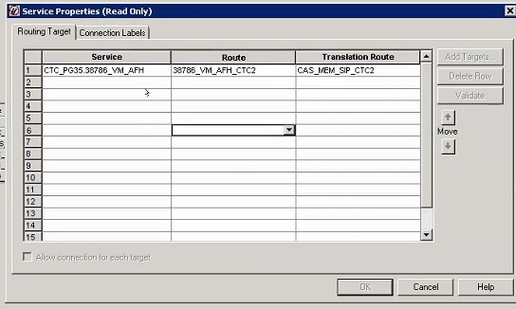
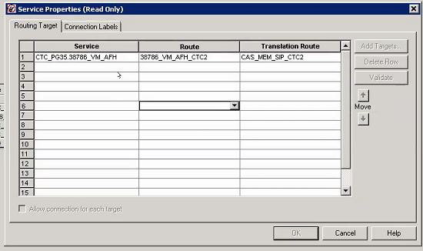
ICM Part: Routing Script
Spanish Service Properties
English Service Properties

Slide 26
PBX Part

Slide 27
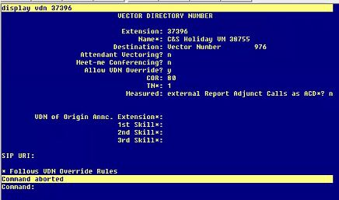
PBX Part
VDN 37396 from the route select node on the routing script. (The route select node with 4 services)

Slide 28
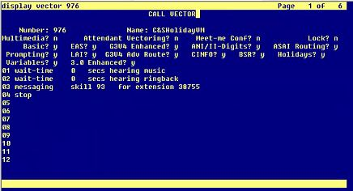
PBX Part
Vector 976 from VDN 37696. In this example, the after office treatment goes to VM 38755.

Slide 29
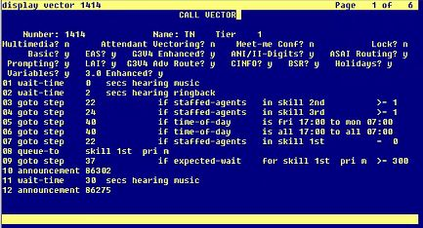
PBX Part
Vector cleanup is needed to some vectors when migrating to HOOPS.
TOD, emergency and holiday checks need to be removed.

Slide 30
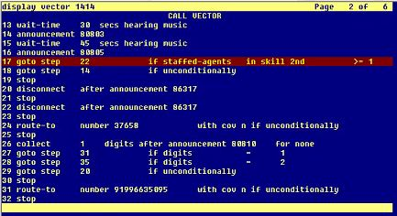
PBX Part
Emergency check has to be replaced with staff check.

Slide 31
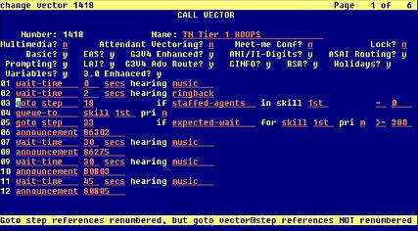
PBX Part
Clear the steps 3-6 to make the new vector look like this. Notice that TOD, holiday and emergency checks have been removed.

Slide 32
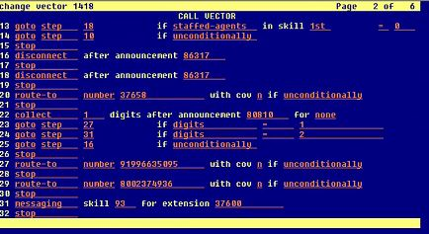
PBX Part
Replace the emergency check within the loop with a staff check.

Slide 33
Thank You.

